Slide 1
The 20th century literature

Slide 2
Society
World wars
Conflicts/ like
1. the racial suffering in American

Slide 3
Literature
1. themes
2. women’s wave paved the ways for many women’s writings
3.media

Slide 4
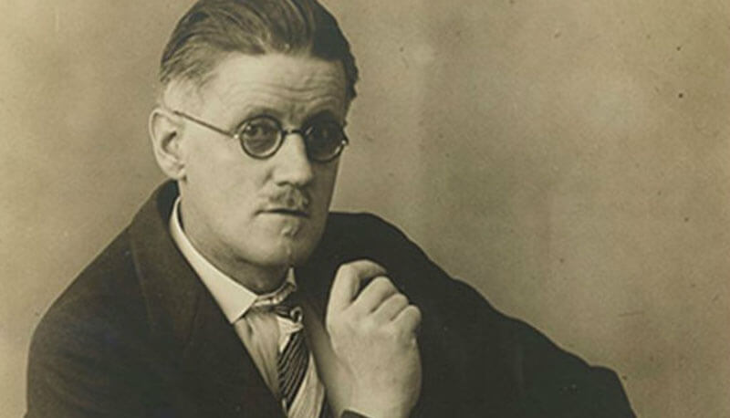
James Joyce (1882-1941)
Irish
Wrote about Dublin
Dubliners, A portrait of the Artist as A Young Man
Ulysses / masterpiece/ stream of consciousness

Slide 5
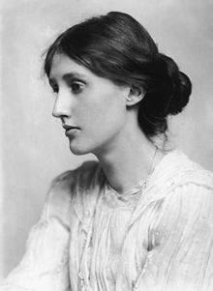
Virginia Woolf
Experimental
Inner Life/ heavily influenced by James Joyce
Stream of consciousness
A Room of one’s own (1929)/ talked about if a woman has her own money
To the lighthouse (1927)
Mrs. Dalloway (1925)
Committed suicide

Slide 6
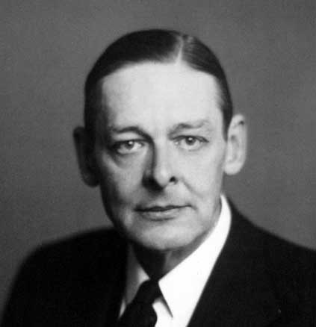
T.S. Eliot (1888-1965)
Leader of the modern poetry
Free verse
The Waste Land/ modern crises and the lack
Of humanity

Slide 7
George Orwell (1903-1950)
Injustice
The Animal Farm
1984
Satire against the political and social systems of the modern age and regimes.

Slide 8
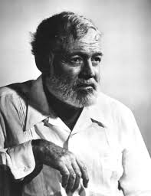
Ernest Hemingway
American Writer
Blamed his mother for father’s death
The old Man and the Se
WW I/ ambulance driver/ he badly wounded
Fear of death
Main themes: death that has a special value, violence, deep sea fishing
Worked as a journalist after the war
Nobel Prize in 1954
Drinking
Suicide/ he suffered from a hyper attention diabetes ended to depression. He feared physical decline and he chose to commit suicide in his home in 1961

Slide 9
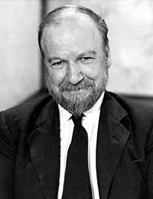
William Golding(1911 –1993)
a British novelist, playwright, and poet.
Best known for his novel Lord of the Flies,
Nobel Prize in Literature
awarded the Booker Prize for fiction in 1980 for his novel Rites of Passage

Slide 10
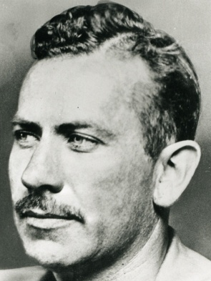
John Steinbeck (1902-1968)
an American author.
He won the 1962 Nobel Prize in Literature "for his realistic and imaginative writings, combining as they do sympathetic humour and keen social perception.“
He has been called "a giant of American letters”
The Pulitzer Prize-winning The Grapes of Wrath (1939)
His works frequently explored the themes of fate and injustice

Slide 11
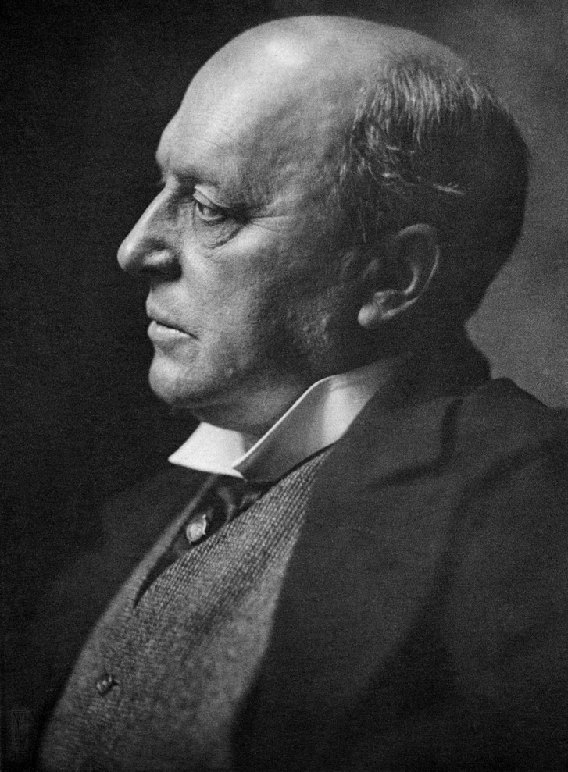
Henry James (1843 – 1916)
was an American-British author regarded as a key
transitional figure between literary realism and
literary modernism.
the brother of renowned philosopher and psychologist William James
The Portrait of a Lady, The Ambassadors, and The Wings of the Dove
James explores this clash of personalities and cultures, in stories of personal relationships in which power is exercised well or badly. His protagonists were often young American women facing oppression or abuse

Slide 12
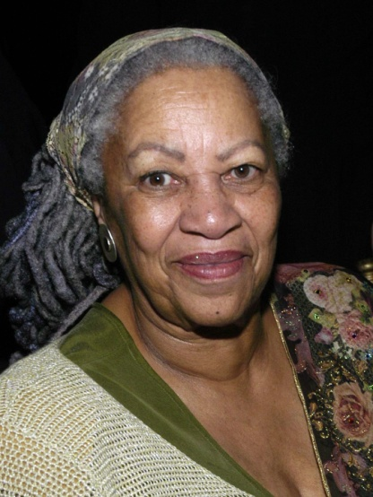
Toni Morrison(1931-)
Morrison won the Pulitzer Prize and the American Book Award in 1988 for Beloved
her first novel, The Bluest Eye (1970)
Morrison's second novel Sula (1973), about a friendship between two black women
In 2012, she responded to a question
about the difference between black
and white feminists in the 1970s.
"Womanists is what black feminists
used to call themselves

Slide 13
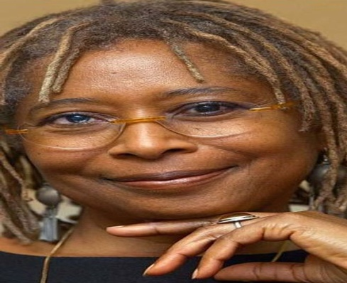
Alice Walker (1944)
an American novelist, short story writer, poet, and activist.
She wrote the novel The Color Purple (1982), for which she won the National Book Award for hardcover fiction, and the Pulitzer Prize for Fiction.
Activism and political criticism
met Martin Luther King Jr. activist in the Civil Rights Movement
On March 8, 2003, International Women's Day, on the eve of the Iraq War, Walker was arrested with 26 others
women of color and the feminist movement
at "the intersection of race, class,
and gender oppression

